Slide 1

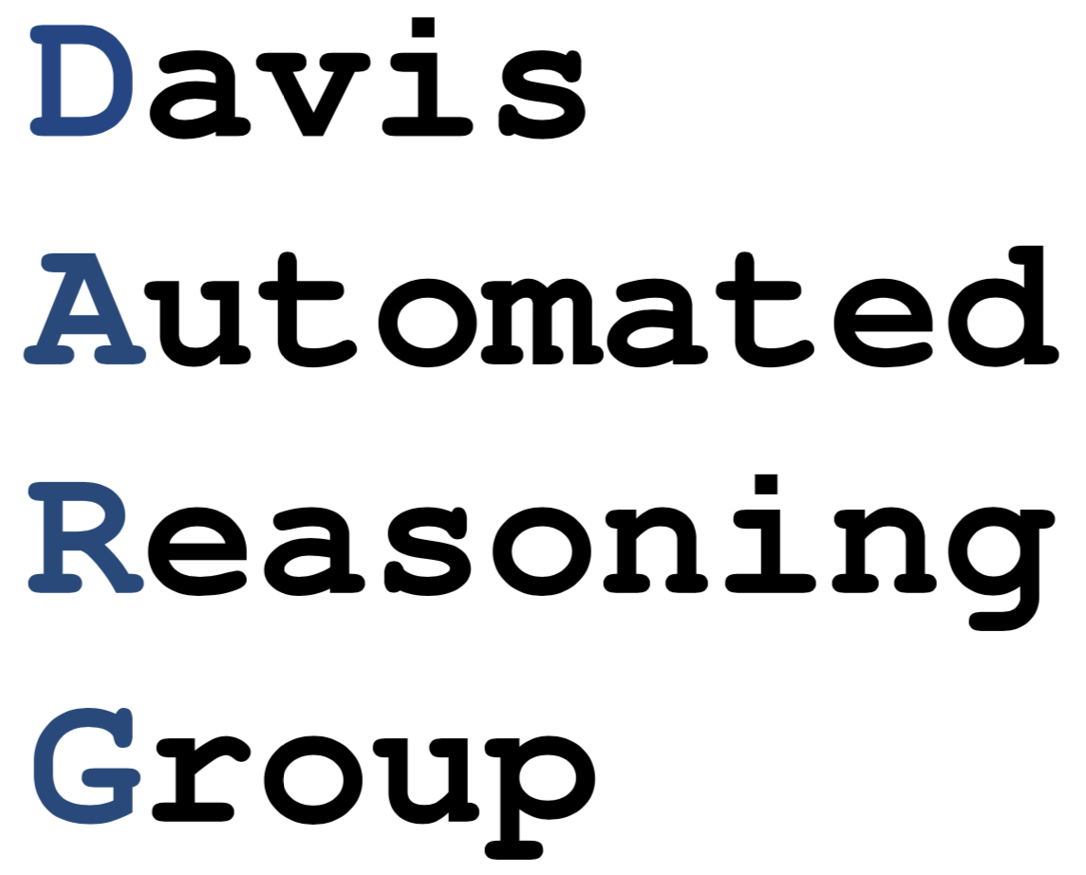
Algorithms and Applications for Provable Repair of Deep Neural Networks
Aditya V. Thakur
Zhe Tao
Stephanie Nawas
Funded by NSF grant CCF-2048123 and DOE grant DE-SC0022285
http://dnn.repair
Notes:
Let’s first break down the title and understand it.
The first part is deep neural networks.

Slide 2
Algorithms and Applications for Provable Repair of Deep Neural Networks
Why
Context and background
Notes:
Let’s first break down the title and understand it.
The first part is deep neural networks.

Slide 3
Algorithms and Applications for Provable Repair of Deep Neural Networks
Why
Context and background
What
Problem statement, experimental results, and code demo
Notes:
Let’s first break down the title and understand it.
The first part is deep neural networks.

Slide 4
Algorithms and Applications for Provable Repair of Deep Neural Networks
Why
Context and background
What
Problem statement, experimental results, and code demo
How
Details of approach
Notes:
Let’s first break down the title and understand it.
The first part is deep neural networks.

Slide 5
Algorithms and Applications for Provable Repair of Deep Neural Networks
Why
Context and background
Notes:
Let’s first break down the title and understand it.
The first part is deep neural networks.

Slide 6
Deep Neural Networks
Notes:
Let’s first break down the title and understand it.
The first part is deep neural networks.

Slide 7
DNN Applications
Notes:
Including .. Such as, NLP such as sententimal, scientitif, sych ,

Slide 8
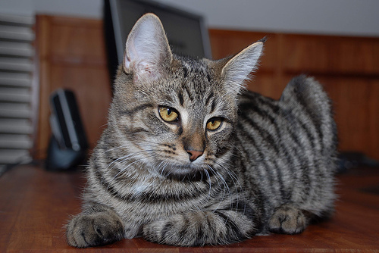
DNN Applications
Computer Vision
“cat”
Notes:
Including .. Such as, NLP such as sententimal, scientitif, sych ,

Slide 9
DNN Applications
Computer Vision
Natural Language Processing
“cat”
“You'll probably love it.”
positive

Slide 10
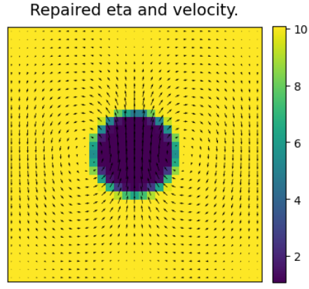
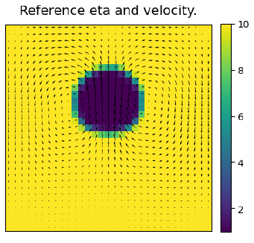
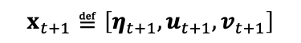
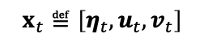
DNN Applications
Computer Vision
Natural Language Processing
“cat”
“You'll probably love it.”
positive
Scientific Computing
$$x_{t}≝\left[η_{t},u_{t},v_{t}\right]$$
$$x_{t+1}≝\left[η_{t+1},u_{t+1},v_{t+1}\right]$$

Slide 11
DNN Applications
Computer Vision
Natural Language Processing
“cat”
“You'll probably love it.”
positive
Scientific Computing
Safety-Critical Controllers
“turn left”
$$x_{t}≝\left[η_{t},u_{t},v_{t}\right]$$
$$x_{t+1}≝\left[η_{t+1},u_{t+1},v_{t+1}\right]$$

Slide 12
DNN Applications
Computer Vision
Natural Language Processing
“cat”
“You'll probably love it.”
positive
Scientific Computing
Safety-Critical Controllers
“turn left”
$$x_{t}≝\left[η_{t},u_{t},v_{t}\right]$$
$$x_{t+1}≝\left[η_{t+1},u_{t+1},v_{t+1}\right]$$

Slide 13
DNNs have gotten bigger and more complex
Algorithmic improvements
Availability of data
DNN
Software improvements
Hardware improvements

Slide 14
DNNs are not infallible

Slide 15
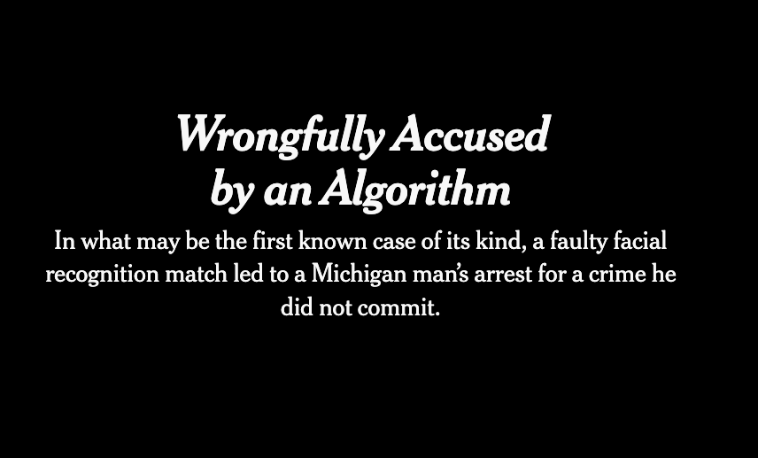
DNNs are not infallible
NYTimes, June 24 2020

Slide 16
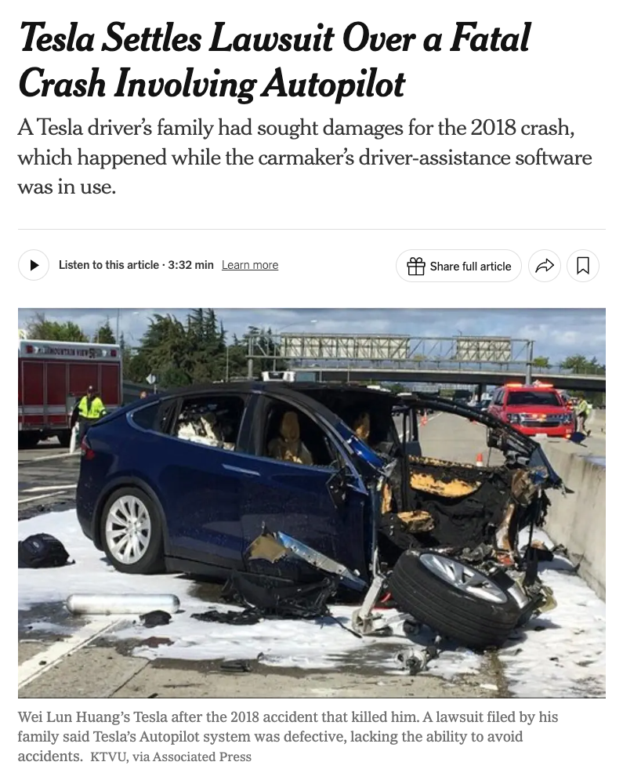
DNNs are not infallible
NYTimes, April 8 2024

Slide 17

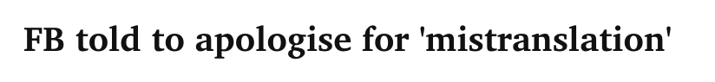
DNNs are not infallible
The Guardian, Oct 24 2017
Bangkok Post, July 31 2020

Slide 18
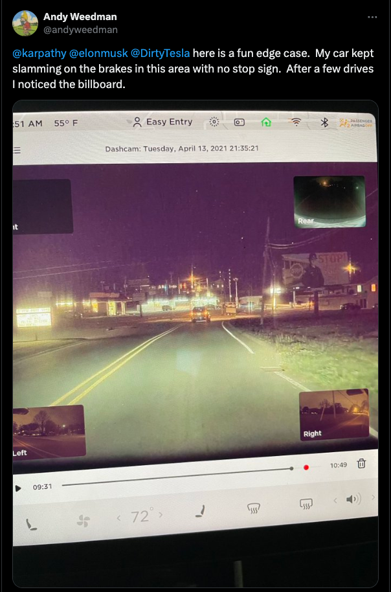
DNNs are not infallible
x.com, April 14 2021

Slide 19
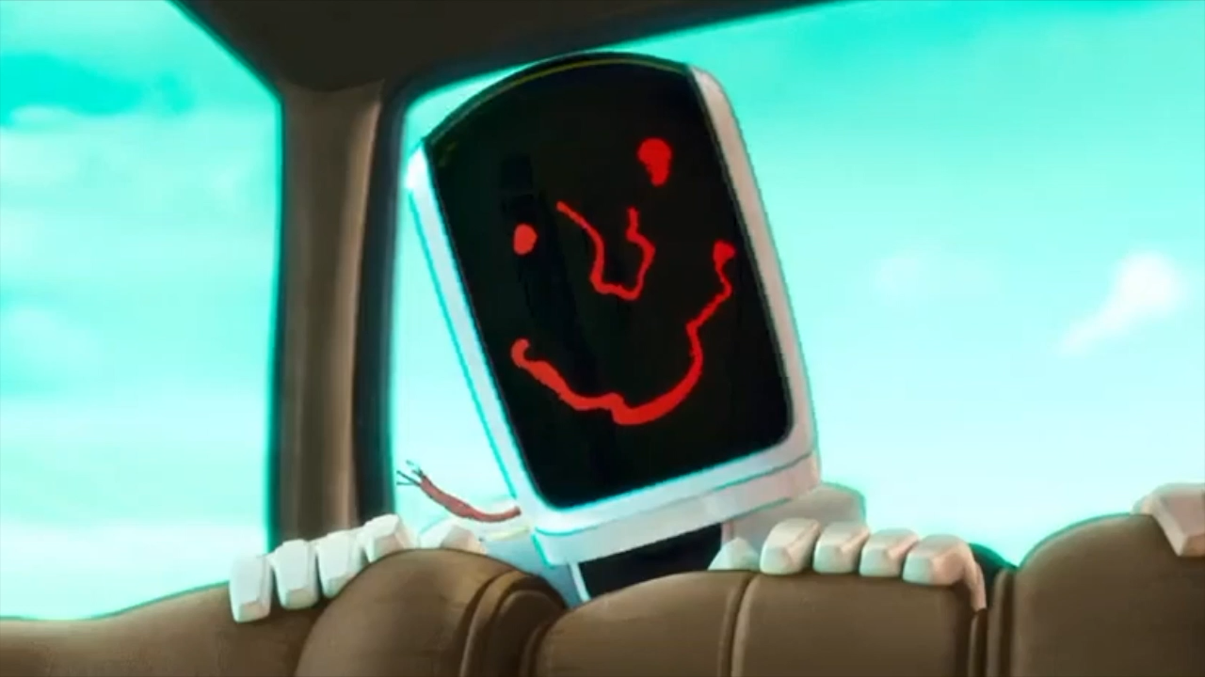
DNNs are not infallible
“The Mitchells Vs. The Machines” (2021) Sony Pictures Animations

Slide 20
Repair of Deep Neural Networks:

Slide 21
Repairing DNNs
What if the output of DNN is not correct?
DNN
“Loaf of bread”
Input

Slide 22
Repairing DNNs
Modify the parameters of the DNN to correct its behavior
Repaired DNN
“dog”
Input

Slide 23
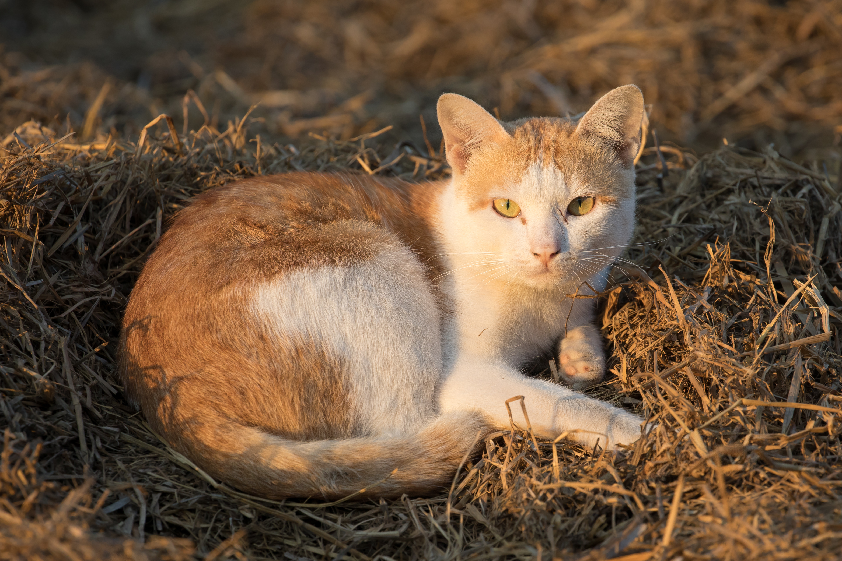
Repairing DNNs
Repair should be local (not impact unrelated inputs).
Repaired DNN
“cat”
Input

Slide 24

Repairing DNNs
Repair should generalize to other similar inputs
Repaired DNN
“dog”
Input

Slide 25
Deep Neural Networks:

Slide 26
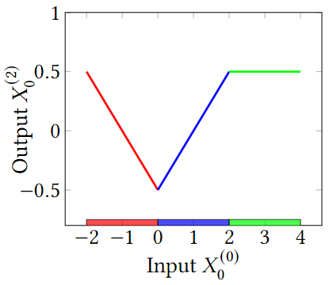
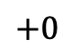
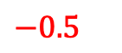
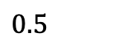

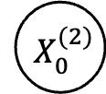
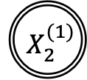
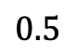
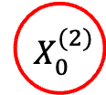
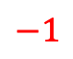

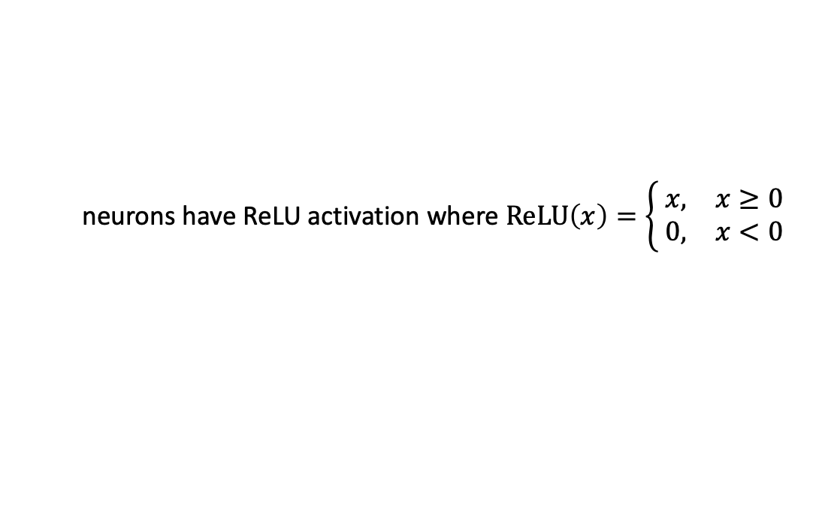

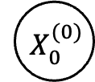

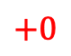
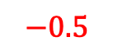
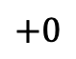
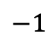
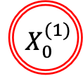
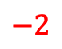
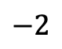
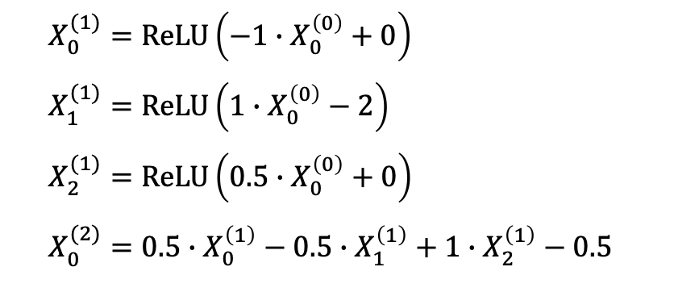
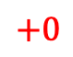
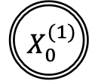
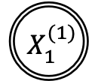
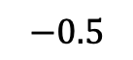
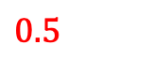
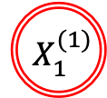
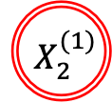
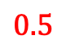
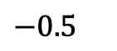
Overview: DNN Semantics
$$+0$$
$$+0$$
$${ X}_{0}^{(1)}$$
$${ X}_{0}^{(1)}$$
$$−1$$
$X_{0}^{(1)}=ReLU\left(−1∙X_{0}^{\left(0\right)}+0\right)$
$X_{1}^{(1)}=ReLU\left(1∙X_{0}^{\left(0\right)}−2\right)$
$X_{2}^{(1)}=ReLU\left(0.5∙X_{0}^{\left(0\right)}+0\right)$
$X_{0}^{(2)}=0.5∙X_{0}^{\left(1\right)}−0.5∙X_{1}^{\left(1\right)}+1∙X_{2}^{\left(1\right)}−0.5$
$$−1$$
$$0.5$$
$$0.5$$
$$−2$$
$$−2$$
$$−0.5$$
$$−0.5$$
$$1$$
$$1$$
$$−0.5$$
$${ X}_{0}^{(0)}$$
$$−0.5$$
$${ X}_{0}^{(0)}$$
$${ X}_{1}^{(1)}$$
$${ X}_{1}^{(1)}$$
$${ X}_{0}^{(2)}$$
$${ X}_{0}^{(2)}$$
$$0.5$$
$$0.5$$
$$1$$
$$1$$
$$+0$$
$$+0$$
$${ X}_{2}^{(1)}$$
$${ X}_{2}^{(1)}$$
$$N\left(X_{0}^{(0)}\right)=0.5∙ReLU\left(−1∙X_{0}^{\left(0\right)}+0\right)−0.5∙ReLU\left(1∙X_{0}^{\left(0\right)}−2\right)+1∙ReLU\left(0.5∙X_{0}^{\left(0\right)}+0\right)−0.5$$
neurons have ReLU activation where $ReLU\left(x\right)=\left\{ \begin{matrix}x, & x≥0 \\ 0, & x<0\end{matrix}\right.$
Notes:
This (layered) directed graph represents a DNN, where we have …
weights on the edges, …
and biases on the neurons.
The input to a neuron is the weighted sum of previous neurons.
For a ReLU neuron (represented by a double-circled node)
if the input is not negative, then the output is the same as the input; …
otherwise the output is zero.
The network is a function of its input as shown in this plot

Slide 27
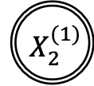
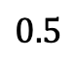
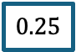
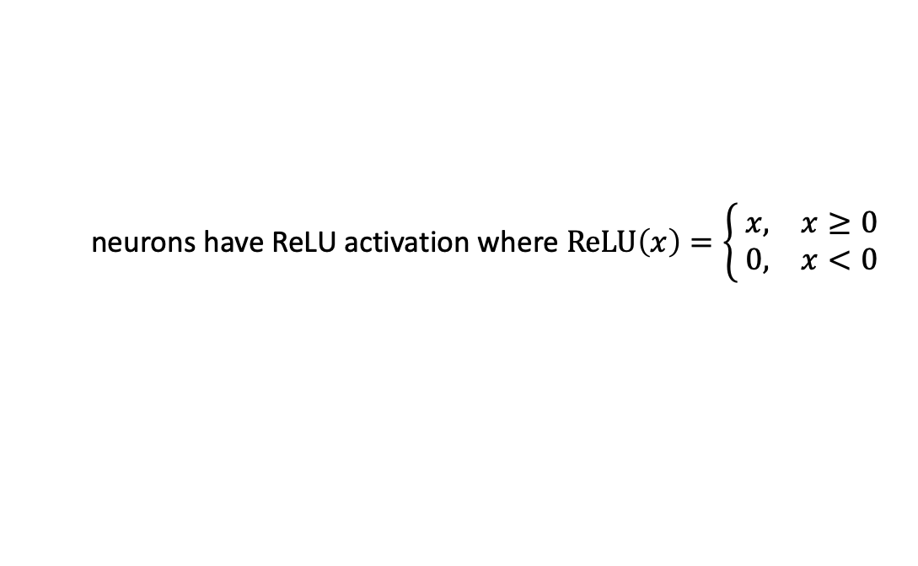


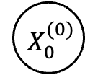
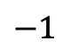

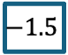
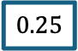
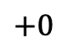
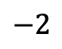























Overview: DNN Semantics
$$+0$$
on
$${ X}_{0}^{(1)}$$
$$−1$$
$$1.5$$
$$1.5$$
$$0.5$$
$$−2$$
$$−0.5$$
$$0.25$$
$$1$$
off
$$−0.5$$
$${ X}_{0}^{(0)}$$
$${ X}_{1}^{(1)}$$
$${ X}_{0}^{(2)}$$
$$−1.5$$
$$0.5$$
$$−3.5$$
$$0$$
$$0.25$$
$$1$$
$$+0$$
$${ X}_{2}^{(1)}$$
off
$$−0.75$$
$$0$$
$$−1.5$$
on
off
off
$$N\left(X_{0}^{(0)}\right)=0.5∙ReLU\left(−1∙X_{0}^{\left(0\right)}+0\right)−0.5∙ReLU\left(1∙X_{0}^{\left(0\right)}−2\right)+1∙ReLU\left(0.5∙X_{0}^{\left(0\right)}+0\right)−0.5$$
$$0.25$$
$$−1.5$$
$$1.5$$
$$0$$
$$0$$
$$−3.5$$
$$−1.5$$
$$−0.75$$
$$1.5$$
$$−1.5$$
$$−1.5$$
neurons have ReLU activation where $ReLU\left(x\right)=\left\{ \begin{matrix}x, & x≥0 \\ 0, & x<0\end{matrix}\right.$
Notes:
For example, given network input “-1.5”, …
2. … the input to the first ReLU neuron is 1.5. Because the input is positive …
3. … the first ReLU neuron is on …
4. … and outputs 1.5.
5. Similarly, the inputs to the other two ReLU neurons are negative, …
6. … hence they are off …
7. …and output zeros.
5. Hence the network output is 0.25.

Slide 28

DNNs are loop-free programs
Alternating layers of affine and non-linear layers
$ReLU\left(x\right)= 0, x<0$
$= x, otherwise$

Slide 29
Repair of Deep Neural Networks:

Slide 30
Repair of “Traditional” Programs

Slide 31



Repair of “Traditional” Programs
human
program
bug
write
deploy, test, verify
human
repair
report

Slide 32
Repair of A Binary Search Program
int binarySearch (int[] arr, int key, int low, int high) {
while (low <= high) {
int mid = (low + high) / 2;
if (arr[mid] < key)
low = mid + 1;
else if (arr[mid] > key)
high = mid - 1;
else
return mid; // key found
}
return -1; // key not found
}
human
program
bug
write
deploy, test, verify
human
repair
report

Slide 33

Repair of A Binary Search Program
int binarySearch (int[] arr, int key, int low, int high) {
while (low <= high) {
int mid = (low + high) / 2;
if (arr[mid] < key)
low = mid + 1;
else if (arr[mid] > key)
high = mid - 1;
else
return mid; // key found
}
return -1; // key not found
}
Bug #1: Integer Overflow
when low == 1 and high == 2147483647,
mid should be 1073741824 but not -1073741824
human
program
bug
write
deploy, test, verify
human
repair
report

Slide 34
Repair of A Binary Search Program
A repair that
int binarySearch (int[] arr, int key, int low, int high) {
while (low <= high) {
int mid = 1073741824;
if (arr[mid] < key)
low = mid + 1;
else if (arr[mid] > key)
high = mid - 1;
else
return mid; // key found
}
return -1; // key not found
}
Bug #1: Integer Overflow
when low == 1 and high == 2147483647,
mid should be 1073741824 but not -1073741824
human
program
bug
write
deploy, test, verify
human
repair
report

Slide 35


Repair of A Binary Search Program
A repair that
fixes bug #1
int binarySearch (int[] arr, int key, int low, int high) {
while (low <= high) {
int mid = 1073741824;
if (arr[mid] < key)
low = mid + 1;
else if (arr[mid] > key)
high = mid - 1;
else
return mid; // key found
}
return -1; // key not found
}
Bug #1: Integer Overflow
when low == 1 and high == 2147483647,
mid should be 1073741824 but not -1073741824
human
program
bug
write
deploy, test, verify
human
repair
report

Slide 36
Repair of A Binary Search Program
A repair that
fixes bug #1
but also introduces new bugs
int binarySearch (int[] arr, int key, int low, int high) {
while (low <= high) {
int mid = 1073741824;
if (arr[mid] < key)
low = mid + 1;
else if (arr[mid] > key)
high = mid - 1;
else
return mid; // key found
}
return -1; // key not found
}
Bug #2: Wrong Middle Point
when low == 1 and high == 9,
mid should be 5 but not 1073741824
Bug #1: Integer Overflow
when low == 1 and high == 2147483647,
mid should be 1073741824 but not -1073741824
human
program
bug
write
deploy, test, verify
human
repair
report

Slide 37
Repair of A Binary Search Program
Another repair that
int binarySearch (int[] arr, int key, int low, int high) {
while (low <= high) {
if (low == 1 && high == 2147483647)
int mid = 1073741824;
else
int mid = (low + high) / 2;
if (arr[mid] < key)
low = mid + 1;
else if (arr[mid] > key)
high = mid - 1;
else
return mid; // key found
}
return -1; // key not found
}
Bug #2: Wrong Middle Point
when low == 1 and high == 9,
mid should be 5 but not 1073741824
Bug #1: Integer Overflow
when low == 1 and high == 2147483647,
mid should be 1073741824 but not -1073741824
human
program
bug
write
deploy, test, verify
human
repair
report

Slide 38
Repair of A Binary Search Program
Another repair that
fixes bug #1
int binarySearch (int[] arr, int key, int low, int high) {
while (low <= high) {
if (low == 1 && high == 2147483647)
int mid = 1073741824;
else
int mid = (low + high) / 2;
if (arr[mid] < key)
low = mid + 1;
else if (arr[mid] > key)
high = mid - 1;
else
return mid; // key found
}
return -1; // key not found
}
Bug #2: Wrong Middle Point
when low == 1 and high == 9,
mid should be 5 but not 1073741824
Bug #1: Integer Overflow
when low == 1 and high == 2147483647,
mid should be 1073741824 but not -1073741824
human
program
bug
write
deploy, test, verify
human
repair
report

Slide 39
Repair of A Binary Search Program
Another repair that
fixes bug #1
does not introduce new bugs
int binarySearch (int[] arr, int key, int low, int high) {
while (low <= high) {
if (low == 1 && high == 2147483647)
int mid = 1073741824;
else
int mid = (low + high) / 2;
if (arr[mid] < key)
low = mid + 1;
else if (arr[mid] > key)
high = mid - 1;
else
return mid; // key found
}
return -1; // key not found
}
Bug #2: Wrong Middle Point
when low == 1 and high == 9,
mid should be 5 but not 1073741824
Bug #1: Integer Overflow
when low == 1 and high == 2147483647,
mid should be 1073741824 but not -1073741824
human
program
bug
write
deploy, test, verify
human
repair
report

Slide 40
Repair of A Binary Search Program
Another repair that
fixes bug #1
does not introduce new bugs
but does not fix other integer overflow bugs
int binarySearch (int[] arr, int key, int low, int high) {
while (low <= high) {
if (low == 1 && high == 2147483647)
int mid = 1073741824;
else
int mid = (low + high) / 2;
if (arr[mid] < key)
low = mid + 1;
else if (arr[mid] > key)
high = mid - 1;
else
return mid; // key found
}
return -1; // key not found
}
Bug #3: Integer Overflow
when low == 2 and high == 2147483647,
mid should be 1073741824 but not -1073741824
Bug #2: Wrong Middle Point
when low == 1 and high == 9,
mid should be 5 but not 1073741824
Bug #1: Integer Overflow
when low == 1 and high == 2147483647,
mid should be 1073741824 but not -1073741824
human
program
bug
write
deploy, test, verify
human
repair
report

Slide 41
Repair of A Binary Search Program
A good repair that
int binarySearch (int[] arr, int key, int low, int high) {
while (low <= high) {
int mid = low + ((high - low) / 2);
if (arr[mid] < key)
low = mid + 1;
else if (arr[mid] > key)
high = mid - 1;
else
return mid; // key found
}
return -1; // key not found
}
Bug #3: Integer Overflow
when low == 2 and high == 2147483647,
mid should be 1073741824 but not -1073741824
Bug #2: Wrong Middle Point
when low == 1 and high == 9,
mid should be 5 but not 1073741824
Bug #1: Integer Overflow
when low == 1 and high == 2147483647,
mid should be 1073741824 but not -1073741824
human
program
bug
write
deploy, test, verify
human
repair
report

Slide 42
Repair of A Binary Search Program
A good repair that
fixes all integer overflow bugs
int binarySearch (int[] arr, int key, int low, int high) {
while (low <= high) {
int mid = low + ((high - low) / 2);
if (arr[mid] < key)
low = mid + 1;
else if (arr[mid] > key)
high = mid - 1;
else
return mid; // key found
}
return -1; // key not found
}
Bug #3: Integer Overflow
when low == 2 and high == 2147483647,
mid should be 1073741824 but not -1073741824
Bug #2: Wrong Middle Point
when low == 1 and high == 9,
mid should be 5 but not 1073741824
Bug #1: Integer Overflow
when low == 1 and high == 2147483647,
mid should be 1073741824 but not -1073741824
human
program
bug
write
deploy, test, verify
human
repair
report

Slide 43
Repair of A Binary Search Program
A good repair that
fixes all integer overflow bugs
does not introduce new bugs
int binarySearch (int[] arr, int key, int low, int high) {
while (low <= high) {
int mid = low + ((high - low) / 2);
if (arr[mid] < key)
low = mid + 1;
else if (arr[mid] > key)
high = mid - 1;
else
return mid; // key found
}
return -1; // key not found
}
Bug #3: Integer Overflow
when low == 2 and high == 2147483647,
mid should be 1073741824 but not -1073741824
Bug #2: Wrong Middle Point
when low == 1 and high == 9,
mid should be 5 but not 1073741824
Bug #1: Integer Overflow
when low == 1 and high == 2147483647,
mid should be 1073741824 but not -1073741824
human
program
bug
write
deploy, test, verify
human
repair
report

Slide 44
Repair of A Binary Search Program
Pointwise Specifications
int binarySearch (int[] arr, int key, int low, int high) {
while (low <= high) {
int mid = low + ((high - low) / 2);
if (arr[mid] < key)
low = mid + 1;
else if (arr[mid] > key)
high = mid - 1;
else
return mid; // key found
}
return -1; // key not found
}
Bug #3: Integer Overflow
when low == 2 and high == 2147483647,
mid should be 1073741824 but not -1073741824
Bug #2: Wrong Middle Point
when low == 1 and high == 9,
mid should be 5 but not 1073741824
Bug #1: Integer Overflow
when low == 1 and high == 2147483647,
mid should be 1073741824 but not -1073741824
human
program
bug
write
deploy, test, verify
human
repair
report
Notes:
For now, all the repair specifications are talking about specific cases.
We refer them as pointwise specification.

Slide 45


Repair of A Binary Search Program
Polytope Specifications
int binarySearch (int[] arr, int key, int low, int high) {
while (low <= high) {
int mid = low + ((high - low) / 2);
if (arr[mid] < key)
low = mid + 1;
else if (arr[mid] > key)
high = mid - 1;
else
return mid; // key found
}
return -1; // key not found
}
Spec #1: Binary Search Invariant
$$∀low.∀high. low≤high⟹$$
$$low≤mid≤high$$
Spec #2: Functional Correctness
$$∀low.∀high. low≤high⟹$$
$$mid=\left\lfloor (low+high)/2\right\rfloor$$
human
program
bug
write
deploy, test, verify
human
repair
report
Notes:
However, there are more powerful specifications
Which talks about a finite or infinite set of cases,
We refer them as polytope repair specifications.
For example, the binary search invariant says for all low less than high, middle is in between of low and high
The functional correctness

Slide 46
Repair of “Traditional” Programs
Notes:
Now we have a brief idea of the repair of traditional programs.
DNNs are also just programs. They can make mistakes. And when a bug is found, we need to repair it just like we need to repair other programs.

Slide 47
Repair of Deep Neural Networks

Slide 48



Repair of DNNs
data
DNN
bug
training
algorithm
deploy, test, verify
human
repair
report
report
repair
algorithm

Slide 49


Repair of An Image Recognition DNN
The repair algorithm should
modify the DNN to correct its behavior;
generalize to similar inputs;
not impact unrelated inputs.
ImageNet
ResNet152
“cat”
“bird”
“dog”
data
DNN
bug
training
algorithm
deploy, test, verify
,“dog”
repair
report
repair
algorithm

Slide 50
Repair of An Image Recognition DNN
ImageNet
ResNet152
“bird”
Notes:
The repair of such specific cases is referred as pointwise repair.
For image recognition networks,

Slide 51
Local Robustness Repair of An Image Recognition DNN
ImageNet
ResNet152
“bird”
Be “locally robust” to the image
Notes:
we also want the network to be locally robust to the input image

Slide 52


Local Robustness Repair of An Image Recognition DNN
perturbed
image
ImageNet
ResNet152
“bird”
Be “locally robust” to the image
any
$L_{∞}$ box centered at the original image
Notes:
Which means for any perturbed image around the input,
The network should also correctly classify it
The set of all such perturbed images can be represented as a polytope

Slide 53


Polytope Repair of An Image Recognition DNN
perturbed
image
ImageNet
ResNet152
“bird”
$$∀ X∈ .N\left(X\right)⊨ψ$$
any
Input polytope
Notes:
And the local robustness repair is an instance of polytope repair of DNNs
Where for all inputs in a polytope, the network output should satisfy the specification psi.

Slide 54
Repair of Deep Neural Networks Prior Approaches

Slide 55




Prior Repair Approaches of DNNs: Retraining
Train the DNN with original training data and buggy inputs.
Buggy Images
Retrained DNN $N^{θ^{′}}$
Retraining
Training Data
Notes:
One repair approach is to retrain the network with the original data and new buggy inputs.

Slide 56
Prior Repair Approaches of DNNs: Retraining
Not Provable
Not Provable
No guarantees that behavior will be corrected.
Buggy Images
Retrained DNN $N^{θ^{′}}$
Retraining
Training Data
Notes:
However, retraining does not guarantee to repair the network

Slide 57
Prior Repair Approaches of DNNs: Retraining
Not Provable
No Polytope Repair
Does Not Support Polytope Repair
Buggy Images
Retrained DNN $N^{θ^{′}}$
Retraining
Training Data
Notes:
…, does not support polytope repair, …

Slide 58

Prior Repair Approaches of DNNs: Retraining
Not Provable
No Polytope Repair
Not Efficient
Computationally Expensive
Takes days to months on GPU servers.
Buggy Images
Retrained DNN $N^{θ^{′}}$
Retraining
Training Data
Notes:
…, is not efficient, …

Slide 59
Prior Repair Approaches of DNNs: Retraining
Not Provable
No Polytope Repair
Not Efficient
May Not Applicable
Requires Access to Training Data
Training data might not be available. E.g., lost, private, etc.
Buggy Images
Retrained DNN $N^{θ^{′}}$
Retraining
Training Data
Notes:
…, and requires the training data, which might not be available.

Slide 60


Prior Repair Approaches of DNNs: Fine-Tuning
Gradient descent on the DNN with only the buggy inputs.
Buggy Images
DNN $N^{θ}$
Fine-Tuned DNN $N^{θ^{′}}$
Fine-Tuning
Notes:
Another approach is to Fine-Tune the network with only the buggy inputs.

Slide 61
Prior Repair Approaches of DNNs: Fine-Tuning
Not Provable
No Polytope Repair
Buggy Images
DNN $N^{θ}$
Fine-Tuned DNN $N^{θ^{′}}$
Fine-Tuning
Notes:
It also does not guarantee to repair the network,
does not support polytope repair, …

Slide 62


Prior Repair Approaches of DNNs: Fine-Tuning
Not Provable
No Polytope Repair
Less Effective
Effectiveness dependent on hyperparameters
Buggy Images
DNN $N^{θ}$
Fine-Tuned DNN $N^{θ^{′}}$
Fine-Tuning
Notes:
… and is less effective.

Slide 63
Algorithms and Applications for Provable Repair of Deep Neural Networks
Why
Context and background
Notes:
Let’s first break down the title and understand it.
The first part is deep neural networks.

Slide 64
Algorithms and Applications for Provable Repair of Deep Neural Networks
Why
Context and background
What
Problem statement and code demo
Notes:
Let’s first break down the title and understand it.
The first part is deep neural networks.

Slide 65
Algorithms and Applications for Provable Repair of Deep Neural Networks
Why
Context and background
What
Problem statement, experimental results, and code demo
Notes:
Let’s first break down the title and understand it.
The first part is deep neural networks.

Slide 66
Repair of Deep Neural Networks

Slide 67
Repair of Deep Neural Networks

Slide 68
Provable Repair of Deep Neural Networks
Notes:
To address limitations of prior repair approaches,
We are developing provable repair of deep neural networks,
Which is the topic of my thesis.

Slide 69


Provable Repair of Deep Neural Networks
Provable
Provides Strong Guarantees
If a repair is found, the repaired DNN is proved to satisfy the repair specification
$$∀ X∈ .N\left(X\right)⊨ψ$$
DNN $N^{θ}$
Repaired DNN $N^{θ^{′}}$
Provable Repair

Slide 70
Provable Repair of Deep Neural Networks
Provable
Polytope Repair
Supports Polytope Repair
Handles symbolic constraints or properties.
$$∀ X∈ .N\left(X\right)⊨ψ$$
DNN $N^{θ}$
Repaired DNN $N^{θ^{′}}$
Provable Repair

Slide 71

















Overview: Repair Specification
$ψ$ violated
$$0.25$$
Repair Specification
$$ψ≝N\left(−1.5\right)≤0.1$$
$$−1.5$$
$$+0$$
$$−1$$
$$0.5$$
$$−2$$
$$−0.5$$
Provable Repair
$$1$$
$$−0.5$$
$$0.5$$
$$1$$
$$+0$$
DNN $N^{θ}$
Repaired DNN $N^{θ^{′}}$
Notes:
Now let’s look at the repair specification. Given input -1.5, You want the network output to be less than 0.1,
1. and it is violated.

Slide 72
Overview: Provable Pointwise Repair
$ψ$ violated
Repair Specification
$$ψ≝N\left(−1.5\right)≤0.1$$
$$+0$$
$$−1$$
$$0.5$$
$$−2$$
$$−0.5$$
Provable Repair
$$1$$
$$−0.5$$
$$0.5$$
$$1$$
$$+0$$
DNN $N^{θ}$
Repaired DNN $N^{θ^{′}}$
Notes:
What we want to do is to repair the network.

Slide 73














Overview: Provable Pointwise Repair
$$Find parameters$$ | $$\hat{θ}$$
$$that minimizes$$ | $$\left\|\hat{θ}−θ\right\| \text{and}\left\|N^{\hat{θ}}\left(−1.5\right)−N^{θ}\left(−1.5\right)\right\|$$
$$subject to$$ | $$φ$$ | $$≝N^{\hat{θ}}\left(−1.5\right)=\begin{matrix}{\hat{w}}_{0}^{(1)}∙\hat{ReLU}\left({\hat{w}}_{0}^{\left(0\right)}∙−1.5+{\hat{b}}_{0}^{\left(0\right)}\right)+{\hat{b}}_{0}^{\left(1\right)} \\ {\hat{w}}_{1}^{\left(1\right)}∙\hat{ReLU}\left({\hat{w}}_{1}^{\left(0\right)}∙−1.5+{\hat{b}}_{1}^{\left(0\right)}\right)+{\hat{b}}_{0}^{\left(1\right)} \\ {\hat{w}}_{2}^{\left(1\right)}∙\hat{ReLU}\left({\hat{w}}_{2}^{\left(0\right)}∙−1.5+{\hat{b}}_{2}^{\left(0\right)}\right)+{\hat{b}}_{0}^{\left(1\right)}\end{matrix}$$ | $$and$$ | $$ψ$$ | $${≝N}^{\hat{θ}}\left(−1.5\right)≤0.1$$
$$+0$$
$$(Encodes symbolic output N^{\hat{θ}}\left(−1.5\right))$$
$$+{\hat{b}}_{0}^{(0)}$$
$$−1$$
$$0.5$$
$${\hat{w}}_{0}^{(0)}$$
$${\hat{w}}_{0}^{(1)}$$
$$−2$$
$$−0.5$$
$$+{\hat{b}}_{1}^{(0)}$$
$$−0.5$$
$$1$$
$$−0.5$$
$${\hat{w}}_{1}^{(0)}$$
$${\hat{w}}_{1}^{(1)}$$
$$0.5$$
$$1$$
behavioral difference
$${\hat{w}}_{2}^{(0)}$$
$${\hat{w}}_{2}^{(1)}$$
$$+0$$
$$+{\hat{b}}_{2}^{(0)}$$
DNN $N^{θ}$
DNN $N^{\hat{θ}}$
Notes:
Which means to
1. Find new parameters

Slide 74




However, solving $φ∧ψ$ is difficult
$$≝N^{\hat{θ}}(−1.5)={\hat{w}}_{0}^{(1)}∙\hat{ReLU}\left({\hat{w}}_{0}^{\left(0\right)}∙−1.5+{\hat{b}}_{0}^{\left(0\right)}\right)+{\hat{w}}_{1}^{\left(1\right)}∙\hat{ReLU}\left({\hat{w}}_{1}^{\left(0\right)}∙−1.5+{\hat{b}}_{1}^{\left(0\right)}\right)+{\hat{w}}_{2}^{\left(1\right)}∙\hat{ReLU}\left({\hat{w}}_{2}^{\left(0\right)}∙−1.5+{\hat{b}}_{2}^{\left(0\right)}\right)+{\hat{b}}_{0}^{\left(1\right)}$$
$$φ≝$$
Due to disjunctions and quadratic terms
Due to disjunctions and quadratic terms
Due to disjunctions
$$\hat{y}=\hat{ReLU}\left(\hat{x}\right)≝\left(\hat{x}≥0∧\hat{y}=\hat{x}\right)∨\left(\hat{x}<0∧\hat{y}=0\right)$$
Find a linear formula $φ_{lin}$ that implies $φ$,
then solve $φ_{lin}∧ψ$ in polynomial time using an LP solver.
Notes:
However, phi is in general difficult to solve …
due to disjunctions
And quadratic terms.
We want to find a linear formula phi_lin that imples phi, then solve phi_lin and psi in polynomial time.

Slide 75


Modifying only the last layer gives us $φ_{lin}$
$$φ_{lin}≝$$
$$N^{\hat{θ}}(−1.5)={\hat{w}}_{0}^{(1)}∙\hat{ReLU}\left(−1∙−1.5+0\right)+{\hat{w}}_{1}^{\left(1\right)}∙\hat{ReLU}\left(1∙−1.5−2\right)+{\hat{w}}_{2}^{\left(1\right)}∙\hat{ReLU}\left(0.5∙−1.5+0\right)+{\hat{b}}_{0}^{\left(1\right)}$$
Notes:
However, phi is in general difficult to solve …
due to disjunctions
And quadratic terms.
We want to find a linear formula phi_lin that imples phi, then solve phi_lin and psi in polynomial time.

Slide 76

Modifying only the last layer gives us one such $φ_{lin}$
$$φ_{lin}≝$$
$$N^{\hat{θ}}(−1.5)={\hat{w}}_{0}^{\left(1\right)}∙1.5+{\hat{w}}_{1}^{\left(1\right)}∙0+{\hat{w}}_{2}^{\left(1\right)}∙0+{\hat{b}}_{0}^{\left(1\right)}$$
Notes:
However, phi is in general difficult to solve …
due to disjunctions
And quadratic terms.
We want to find a linear formula phi_lin that imples phi, then solve phi_lin and psi in polynomial time.

Slide 77

Modifying only the last layer gives us $φ_{lin}$
$$φ_{lin}≝$$
$$N^{\hat{θ}}(−1.5)={\hat{w}}_{0}^{\left(1\right)}∙1.5+{\hat{b}}_{0}^{\left(1\right)}$$
Notes:
However, phi is in general difficult to solve …
due to disjunctions
And quadratic terms.
We want to find a linear formula phi_lin that imples phi, then solve phi_lin and psi in polynomial time.

Slide 78








Provable Pointwise Repair: Last layer
$$Find parameters$$ | $$\hat{θ}$$
$$that minimizes$$ | $$\left\|\hat{θ}−θ\right\| \text{and}\left\|N^{\hat{θ}}\left(−1.5\right)−N^{θ}\left(−1.5\right)\right\|$$
$$subject to$$ | $$φ_{lin}$$ | $$≝N^{\hat{θ}}\left(−1.5\right)={\hat{w}}_{0}^{\left(1\right)}∙1.5+{\hat{b}}_{0}^{\left(1\right)}$$ | $$and$$ | $$ψ$$ | $${≝N}^{\hat{θ}}\left(−1.5\right)≤0.1$$
$$+0$$
$$−1$$
$${\hat{w}}_{0}^{(1)}$$
$$−2$$
$${\hat{b}}_{0}^{\left(1\right)}$$
$$1$$
$${\hat{w}}_{1}^{(1)}$$
$$0.5$$
$${\hat{w}}_{2}^{(1)}$$
$$+0$$
DNN $N^{\hat{θ}}$
Notes:
And our pointwise repair problem becomes a linear program.

Slide 79









Provable Pointwise Repair: Last layer
$ψ$ violated
Repair Specification
$$ψ≝N\left(−1.5\right)≤0.1$$
$$+0$$
$$+0$$
$$−1$$
$$−1$$
$$0.4$$
$$0.5$$
$$0.5$$
$$−2$$
$$−0.5$$
Provable Repair
$$−2$$
$$−0.5$$
$$1$$
$$−0.5$$
$$1$$
$$−0.5$$
$$0.5$$
$$1$$
$$0.5$$
$$1$$
$$+0$$
$$+0$$
DNN $N^{θ}$
Repaired DNN $N^{θ^{′}}$
Notes:
By solving this linear program,
We get the repaired network,
Which satisfies the repair specification.

Slide 80

Pointwise ImageNet Last Layer Repair
Pointwise Repair Specification
50 misclassified fog-corrupted images from ImageNet-C
fog
Buggy
ResNet152
Last Layer Provable Repair
Repaired
ResNet152
60.2 Million Parameters
3195 seconds
Notes:
Next, we present selected experimental results.
For pointwise ImageNet Repair,
1. APRNN successfully repairs a buggy VGG19 network
2. against fifty fog-corrupted images from ImageNet-C

Slide 81






Pointwise ImageNet Repair: Test Accuracy
ImageNet
Test Set
ResNet152
Repaired
ResNet152
Buggy Original
ResNet152
$$\text{Original}:72.38\%$$
$$−0.38\%$$
$$\text{Repaired} \text{DNN}:72.00\%$$
APRNN accuracy: $72.36\%$
Original accuracy: $72.38\%$
Test accuracy decreased by $0.38\%$!
Notes:
The test accuracy
1. of the APRNN repaired network only decreased slightly

Slide 82
Last layer does not always work

Slide 83
Pointwise ImageNet Last Layer Repair
Pointwise Repair Specification
50 misclassified fog-corrupted images from ImageNet-C
fog
Buggy
VGG19
Last Layer Provable Repair
Failed
runs out of memory
143.7 Million Parameters
Notes:
Next, we present selected experimental results.
For pointwise ImageNet Repair,
1. APRNN successfully repairs a buggy VGG19 network
2. against fifty fog-corrupted images from ImageNet-C

Slide 84
Beyond last layer repair
Even restricted to modifying weights in a single (non-last) layer, provable pointwise repair is NP-hard for feedforward ReLU DNNs
Goldberger, Ben, et al. "Minimal Modifications of Deep Neural Networks using Verification." LPAR. 2020.

Slide 85




Overview: Provable Polytope Repair
Polytope Repair Specification
$$ψ_{1}≝∀X∈\left[−1.5,−0.5\right]. −0.1≤N\left(X\right)≤0.1 \\ ψ_{2}≝∀X∈\left[ 1.5, . 3\right]. 0≤N\left(X\right)≤0.4$$
$$+0$$
$$−0.4$$
$$0.5$$
$$−2$$
$$−0.2$$
Provable Repair
$$1$$
$$−0.5$$
$$0.366$$
$$1$$
$$+0$$
DNN $N^{θ}$
Repaired DNN $N^{θ^{′}}$
Notes:
. This is the repair specification.
. this DNN satisfies psi_1 but not satisfy psi_2
Let’s take a closer look at the DNN

Slide 86


Overview: Provable Polytope Repair
Polytope Repair Specification
$ψ_{1}$ satisfied
$$ψ_{1}≝∀X∈\left[−1.5,−0.5\right]. −0.1≤N\left(X\right)≤0.1 \\ ψ_{2}≝∀X∈\left[ 1.5, . 3\right]. 0≤N\left(X\right)≤0.4$$
$$+0$$
$$−0.4$$
$$0.5$$
$$−2$$
$$−0.2$$
Provable Repair
$$1$$
$$−0.5$$
$$0.366$$
$$1$$
$$+0$$
DNN $N^{θ}$
Repaired DNN $N^{θ^{′}}$
Notes:
. This is the repair specification.
. this DNN satisfies psi_1 but not satisfy psi_2
Let’s take a closer look at the DNN

Slide 87

Overview: Provable Polytope Repair
Polytope Repair Specification
$ψ_{2}$ violated
$$ψ_{1}≝∀X∈\left[−1.5,−0.5\right]. −0.1≤N\left(X\right)≤0.1 \\ ψ_{2}≝∀X∈\left[ 1.5, . 3\right]. 0≤N\left(X\right)≤0.4$$
$$+0$$
$$−0.4$$
$$0.5$$
$$−2$$
$$−0.2$$
Provable Repair
$$1$$
$$−0.5$$
$$0.366$$
$$1$$
$$+0$$
DNN $N^{θ}$
Repaired DNN $N^{θ^{′}}$
Notes:
. This is the repair specification.
. this DNN satisfies psi_1 but not satisfy psi_2
Let’s take a closer look at the DNN

Slide 88
Provable Repair of Deep Neural Networks: Algorithms
Notes:
We have developed three algorithms

Slide 89
Provable Repair Algorithms
PRDNN
Sotoudeh, Matthew, and Aditya V. Thakur. "Provable repair of deep neural networks." PLDI 2021.
APRNN
Zhe Tao, Stephanie Nawas, Jacqueline Mitchell, and Aditya V. Thakur. "Architecture-Preserving Provable Repair of Deep Neural Networks." PLDI 2023.
PRoViT
Stephanie Nawas, Zhe Tao, and Aditya V. Thakur. “Provable Repair of Vision Transformers." SAIV 2024.

Slide 90
Provable Repair Algorithms
Pointwise Repair
PTIME
PTIME
PTIME
PRDNN
APRNN
PRoViT
PTIME: polynomial time
EXPTIME: exponential time

Slide 91
Provable Repair Algorithms
V-Polytope: vertex-representation
Pointwise Repair | Polytope Repair
PTIME | EXPTIME (V-polytope)
PTIME | PTIME (V-polytope)
PTIME | ___
PRDNN
APRNN
PRoViT
PTIME: polynomial time
EXPTIME: exponential time

Slide 92
Provable Repair Algorithms
V-Polytope: vertex-representation
Pointwise Repair | Polytope Repair | Architecture-Preserving
PTIME | EXPTIME (V-polytope) | no
PTIME | PTIME (V-polytope) | yes
PTIME | ___ | yes
PRDNN
APRNN
PRoViT
PTIME: polynomial time
EXPTIME: exponential time

Slide 93
PRDNN
APRNN
PRoViT
“Symbolic PyTorch”
Notes:
APRNN is implemented in our SyTorch framework, which extends PyTorch with symbolic execution capability.
It supports many solver (backends).

Slide 94






PRDNN
APRNN
PRoViT
SyTorch
Standard DNNs
Fully-Connected
Conv. and Pooling
Residual
Group Norm.
Notes:
APRNN is implemented in our SyTorch framework, which extends PyTorch with symbolic execution capability.
It supports many solver (backends).

Slide 95
PRDNN
APRNN
PRoViT
SyTorch
Standard DNNs + Symbolic Semantics
Fully-Connected
Conv. and Pooling
Residual
Group Norm.
Notes:
APRNN is implemented in our SyTorch framework, which extends PyTorch with symbolic execution capability.
It supports many solver (backends).

Slide 96



PRDNN
APRNN
PRoViT
SyTorch
Standard DNNs + Symbolic Semantics
Solvers
$$⋮$$
Fully-Connected
Conv. and Pooling
Residual
Group Norm.
Notes:
APRNN is implemented in our SyTorch framework, which extends PyTorch with symbolic execution capability.
It supports many solver (backends).

Slide 97
Experimental Evaluation
Notes:
Now let’s look at some of our experimental results.

Slide 98
Experimental Evaluation
PRDNN
Sotoudeh, Matthew, and Aditya V. Thakur. "Provable repair of deep neural networks." PLDI 2021.
APRNN
Zhe Tao, Stephanie Nawas, Jacqueline Mitchell, and Aditya V. Thakur. "Architecture-Preserving Provable Repair of Deep Neural Networks." PLDI 2023.

Slide 99
Pointwise ImageNet Repair
Pointwise Repair Specification
50 misclassified fog-corrupted images from ImageNet-C
fog
Buggy
VGG19
APRNN
Repaired
VGG19
143.7 Million Parameters
1,918 seconds
Notes:
Next, we present selected experimental results.
For pointwise ImageNet Repair,
1. APRNN successfully repairs a buggy VGG19 network
2. against fifty fog-corrupted images from ImageNet-C

Slide 100
Pointwise ImageNet Repair
Pointwise Repair Specification
50 misclassified fog-corrupted images from ImageNet-C
fog
Buggy
VGG19
PRDNN
Failed
runs out of memory
143.7 Million Parameters
Notes:
while PRDNN runs out of memory, …

Slide 101



Pointwise ImageNet Repair: Test Accuracy
ImageNet
Test Set
APRNN Repaired
VGG19
Buggy Original
VGG19
VGG19
$$\text{Original}:72.38\%$$
$$−0.02\%$$
$$\text{A}\text{P}\text{R}\text{NN}:72.36\%$$
APRNN accuracy: $72.36\%$
Original accuracy: $72.38\%$
Test accuracy decreased by $0.02\%$!
Notes:
The test accuracy
1. of the APRNN repaired network only decreased slightly

Slide 102







Pointwise ImageNet Repair: Generalization
Generalization accuracy increased $23.00\%$!
ImageNet-C
Generalization Set
$$\text{A}\text{P}\text{R}\text{NN}:23.00\%$$
APRNN Repaired
VGG19
Buggy Original
VGG19
VGG19
$$+23.00\%$$
APRNN accuracy: $23.00\%$
$$\text{Original}:00.00\%$$
Original accuracy: $00.00\%$
Notes:
And the generalization accuracy of similar foggy images
Increased 23%
-----
And we also measure generalization by looking at similar foggy images
1. The original network has zero accuracy on this generalization set
2. And the APRNN repaired network has 23% (sixty-one percent) accuracy.

Slide 103








Polytope MNIST Corruption and Rotation Repair
Polytope Repair Specification
five 784D polytopes with a misclassified fog-corrupted image and its six rotations as vertices
$$×5$$
Buggy
9x100 DNN
APRNN
Repaired
9x100 DNN
150K Parameters
59 seconds
Notes:
Next, in our polytope MNIST corruption and rotation repair,
APRNN repaired a buggy MNIST network,
With a polytope repair specification, where
We take a misclassified foggy image
And its six rotations as vertices of a polytope
And we take five of these
APRNN finished in a minute
(while both PRDNN and REASSURE timed out)

Slide 104
Polytope MNIST Corruption and Rotation Repair
Polytope Repair Specification
five 784D polytopes with a misclassified fog-corrupted image and its six rotations as vertices
$$×5$$
Buggy
9x100 DNN
PRDNN
Failed
times out
150K Parameters
Notes:
(while both PRDNN and REASSURE timed out)

Slide 105







Polytope MNIST Repair: Test Accuracy
Test accuracy even increased $0.07\%$!
MNIST
Test Set
APRNN Repaired
9x100 DNN
$$\text{A}\text{P}\text{R}\text{NN}:95.15\%$$
Buggy Original
9x100 DNN
9x100 DNN
$$+0.07\%$$
$$\text{Original}:95.08\%$$
APRNN accuracy: $95.15\%$
Original accuracy: $95.08\%$
Notes:
We also measured the test accuracy,
1. The original network has a very good test accuracy,
2. And APRNN’s test accuracy even increased slightly.

Slide 106





Polytope MNIST Repair: Generalization
Generalization accuracy increased $60.98\%$!
MNIST-C Rotation Generalization Set
$$\text{A}\text{P}\text{R}\text{NN}:60.98\%$$
APRNN Repaired
9x100 DNN
Buggy Original
9x100 DNN
9x100 DNN
$$+60.98\%$$
APRNN accuracy: $60.98\%$
$$\text{Original}:00.00\%$$
Original accuracy: $00.00\%$
Notes:
And we also measure generalization by looking at other rotated foggy images
1. The original network has zero accuracy on this generalization set
2. And the APRNN repaired network has around 61% (sixty-one percent) accuracy.

Slide 107



Polytope ACAS Xu Global Property Repair
Polytope Repair Specification
All applicable ACAS Xu properties ($ψ_{1}$, $ψ_{2}$, $ψ_{3}$, $ψ_{4}$ and $ψ_{8}$).
Buggy
ACAS Xu $N_{2,9}$
APRNN
Provably Safe ACAS Xu $N_{2,9}$
13K Parameters
102 seconds
Katz, Guy, et al. "Reluplex: An efficient SMT solver for verifying deep neural networks." CAV 2017
Notes:
We also evaluated APRNN on it’s ability to repair complex global properties of the ACAS Xu network.
We took one of these networks, which is known to be buggy.
And all applicable properties
3. APRNN repaired it in about one-hundred seconds, (and the repaired network is provably safe)

Slide 108
Experimental Evaluation
PRoViT
Stephanie Nawas, Zhe Tao, and Aditya V. Thakur. “Provable Repair of Vision Transformers." SAIV 2024.

Slide 109




Pointwise ImageNet Repair
Pointwise Repair Specification
10,000 weather-corrupted rotated images from ImageNet-C
fog
brightness
frost
snow
Buggy
ViT-L/32
PRoViT
Repaired
ViT-L/32
~300 Million Parameters
3,095 seconds
Notes:
Next, we present selected experimental results.
For pointwise ImageNet Repair,
1. APRNN successfully repairs a buggy VGG19 network
2. against fifty fog-corrupted images from ImageNet-C

Slide 110






Pointwise ImageNet Repair: Test Accuracy
ImageNet
Test Set
ViT-L/32
Buggy Original
ViT-L/32
PRoViT Repaired
ViT-L/32
$$\text{Original}:76.97\%$$
$$−0.02\%$$
$$\text{P}\text{R}\text{oViT}:76.95\%$$
Original accuracy: $76.97\%$
PRoViT accuracy: $76.95\%$
Test accuracy decreased by only $0.02\%$!
Notes:
The test accuracy
1. of the APRNN repaired network only decreased slightly

Slide 111







Pointwise ImageNet Repair: Generalization
Generalization accuracy increased $18.61\%$
ImageNet-C
Generalization Set
$$\text{P}\text{R}\text{oViT}:34.61\%$$
PRoViT Repaired
ViT-L/32
Buggy Original
ViT-L/32
ViT-L/32
$$+18.61\%$$
Original accuracy: $16.00\%$
$$\text{Original}:16.00\%$$
$\text{P}\text{R}\text{oViT}$ accuracy: $34.61\%$
Notes:
And the generalization accuracy of similar foggy images
Increased 23%
-----
And we also measure generalization by looking at similar foggy images
1. The original network has zero accuracy on this generalization set
2. And the APRNN repaired network has 23% (sixty-one percent) accuracy.

Slide 112
Pointwise ImageNet Repair
Pointwise Repair Specification
10,000 weather-corrupted rotated images from ImageNet-C
fog
brightness
frost
snow
Buggy
DeiT
PRoViT
Repaired
DeiT
~86 Million Parameters
2,576 seconds
Notes:
Next, we present selected experimental results.
For pointwise ImageNet Repair,
1. APRNN successfully repairs a buggy VGG19 network
2. against fifty fog-corrupted images from ImageNet-C

Slide 113






Pointwise ImageNet Repair: Test Accuracy
ImageNet
Test Set
DeiT
Buggy Original
DeiT
PRoViT Repaired
DeiT
$$\text{Original}:81.74\%$$
$$−0.05\%$$
$$\text{P}\text{R}\text{oViT}:81.69\%$$
Original accuracy: $81.74\%$
PRoViT accuracy: $81.69\%$
Test accuracy decreased by only $0.05\%$!
Notes:
The test accuracy
1. of the APRNN repaired network only decreased slightly

Slide 114






Pointwise ImageNet Repair: Generalization
Generalization accuracy increased $16.41\%$
ImageNet-C
Generalization Set
$$\text{P}\text{R}\text{oViT}:33.86\%$$
Buggy Original
DeiT
PRoViT Repaired
DeiT
DeiT
$$+16.41\%$$
Original accuracy: $17.45\%$
$$\text{Original}:17.45\%$$
$\text{P}\text{R}\text{oViT}$ accuracy: $33.86\%$
Notes:
And the generalization accuracy of similar foggy images
Increased 23%
-----
And we also measure generalization by looking at similar foggy images
1. The original network has zero accuracy on this generalization set
2. And the APRNN repaired network has 23% (sixty-one percent) accuracy.

Slide 115
Code demo
Notes:
Now let’s look at some of our experimental results.

